Slide 1
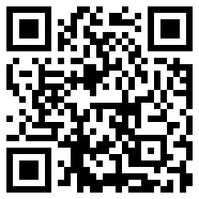
EMC EUROPE 2023
International Symposium and Exhibition on Electromagnetic Compatibility
Kraków, Poland, September 4 - 8, 2023
Organizer:
Special session proposals: January 16, 2023
Paper submission deadline: February 13, 2023
emceurope2023.org

